Slide 1
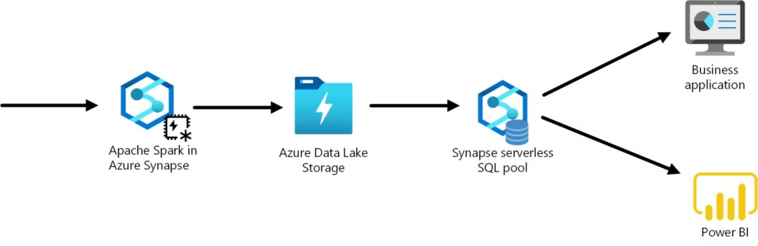
End-to-End Azure Synapse Analytics

Slide 2
Project Workflow
Data Extraction
Data Transformation
Data Storage
Data Analysis
Identify target websites and use automated scripts to extract relevant data.
Cleanse and normalize the extracted data to ensure consistency and accuracy.
Securely store the cleaned data in a scalable cloud-based data lake to build Data warehouse model.
Leverage advanced analytics to uncover insights and trends from the aggregated data.

Slide 3
Challenges in Amazon Site Scraping
Dynamic Content
Anti-Scraping Measures
Data Complexity
Legal Considerations

Slide 4



Leveraging Azure Function for Data Upload
Scalable Cloud Infrastructure
Secure Data Storage
Extracted data is automatically stored in a scalable cloud data warehouse.
Azure Function provides a flexible, serverless platform to handle high-volume data uploads.

Slide 5
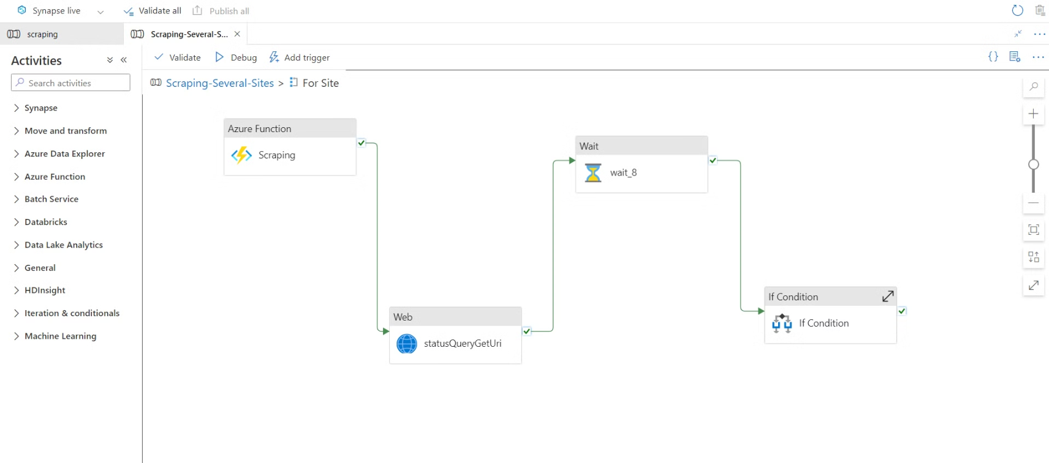

Slide 6
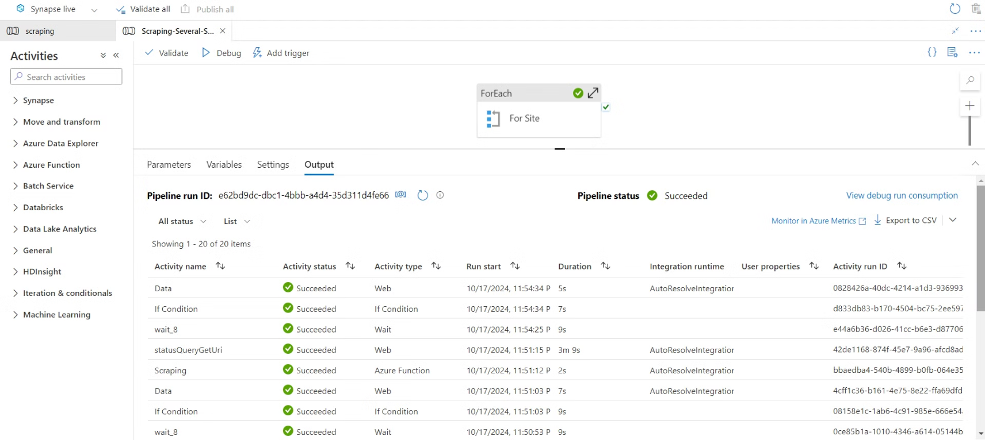

Slide 7
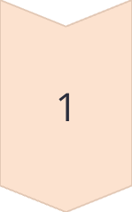
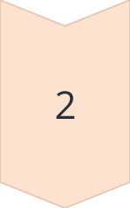
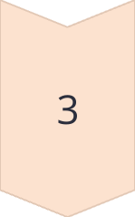
Data Transformation Pipeline
Data Extraction
Raw data is extracted from Azure Data Lake Storage Gen2
Data Transformation
The extracted data is cleansed, normalized, and transformed into a consistent format for analysis.
Data Loading
The cleaned data is securely loaded into a scalable cloud data warehouse for storage and querying.

Slide 8

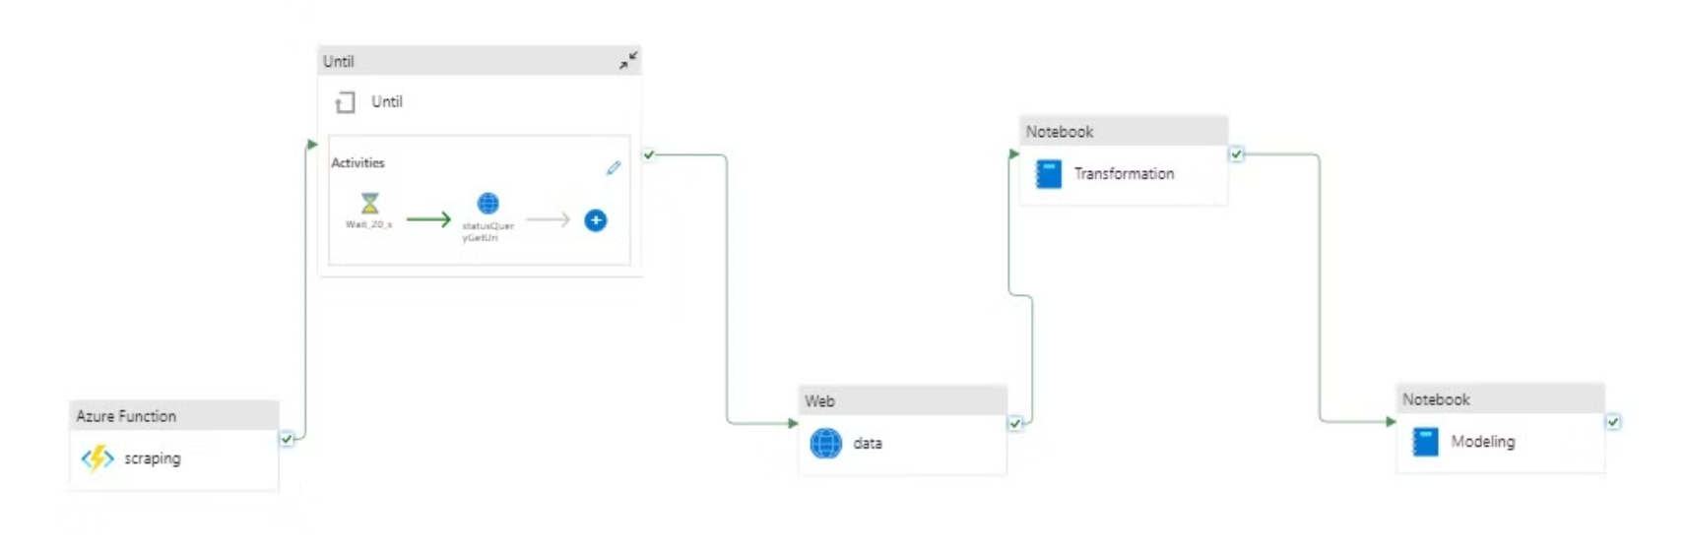

Slide 9

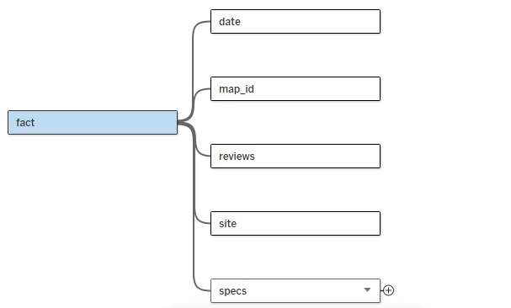
Data Warehousing

Slide 10
Dashboard

Slide 11
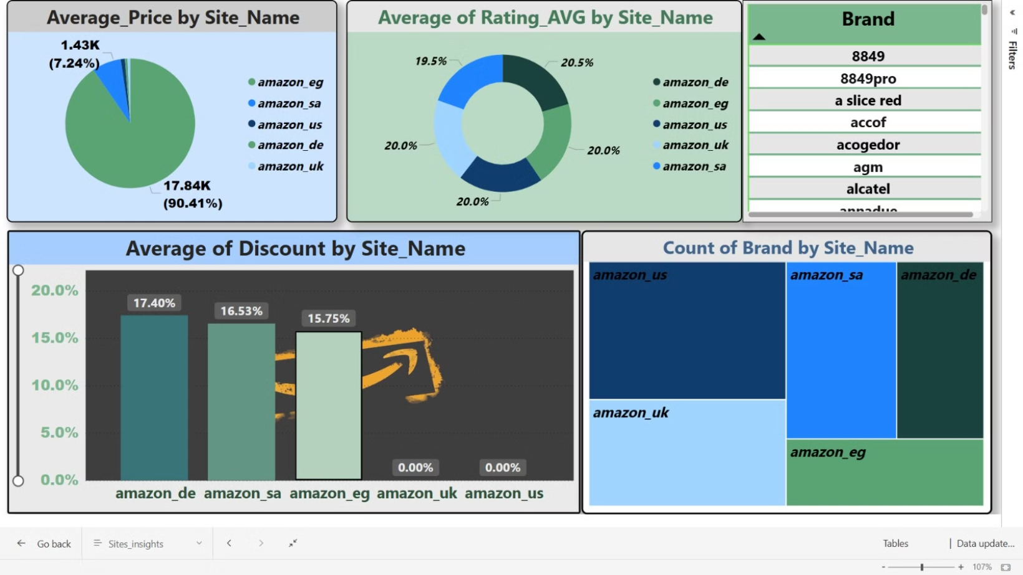

Slide 12
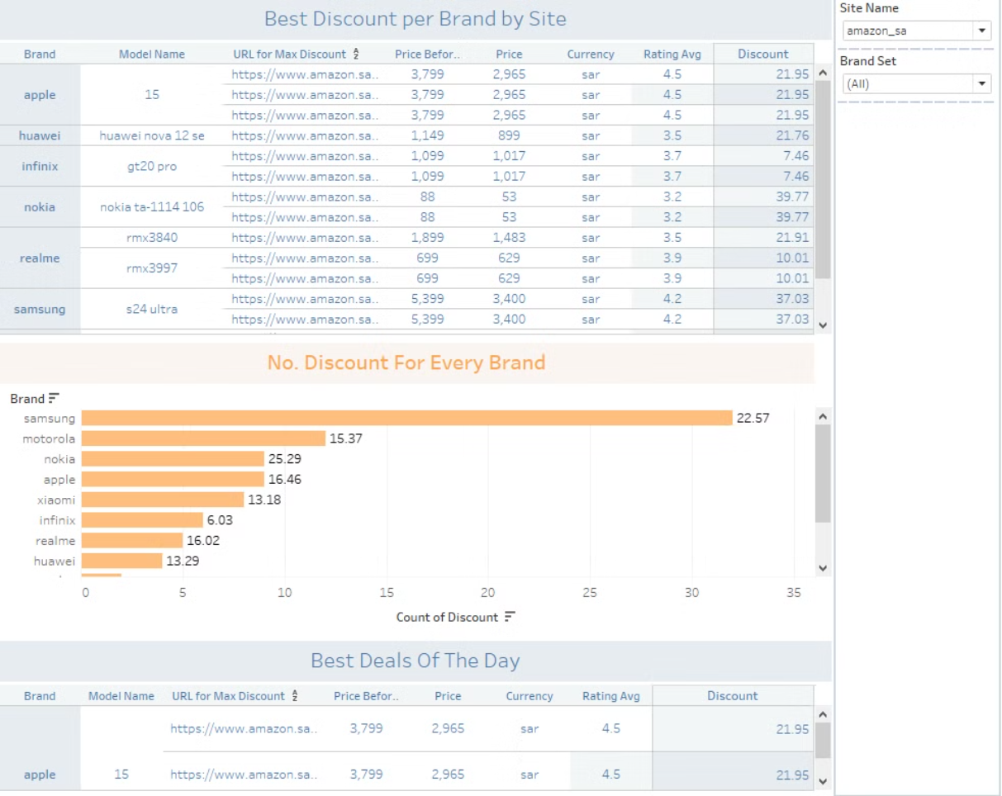

Slide 13
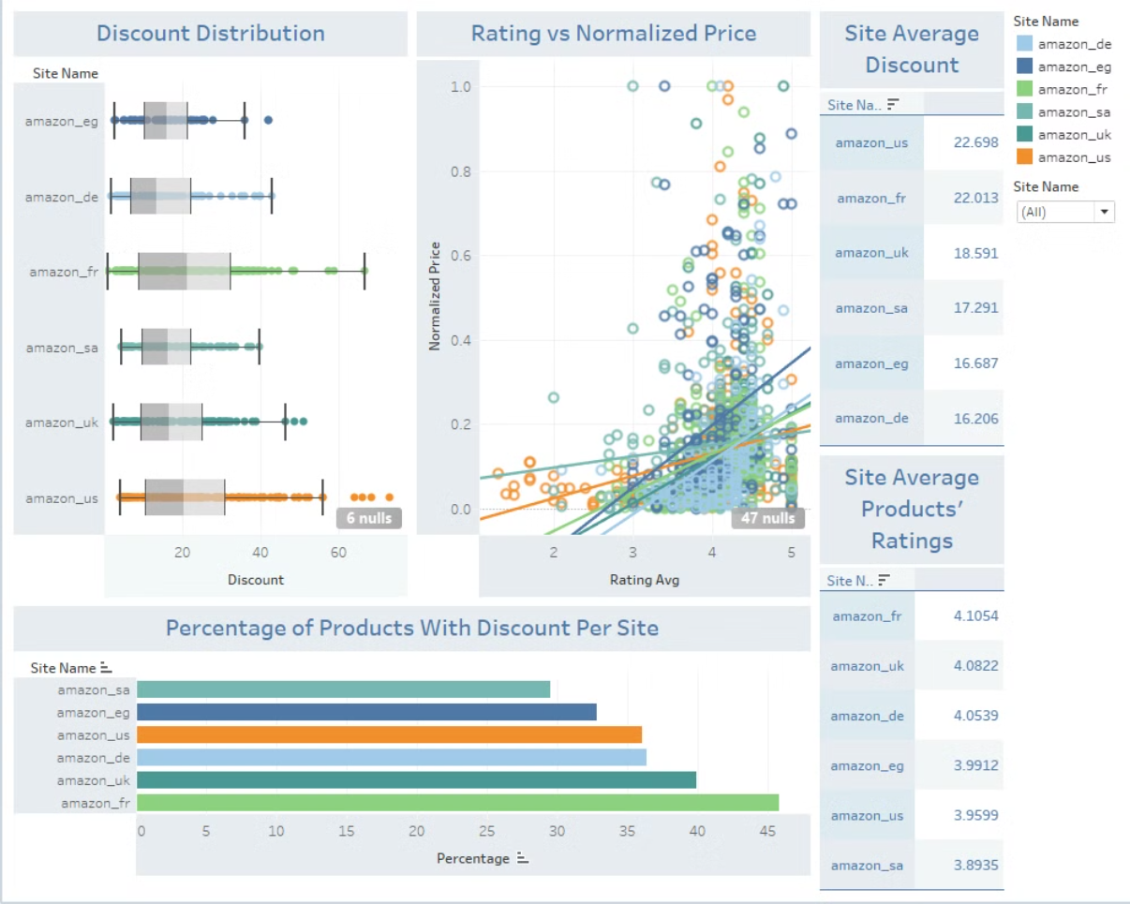

Slide 14
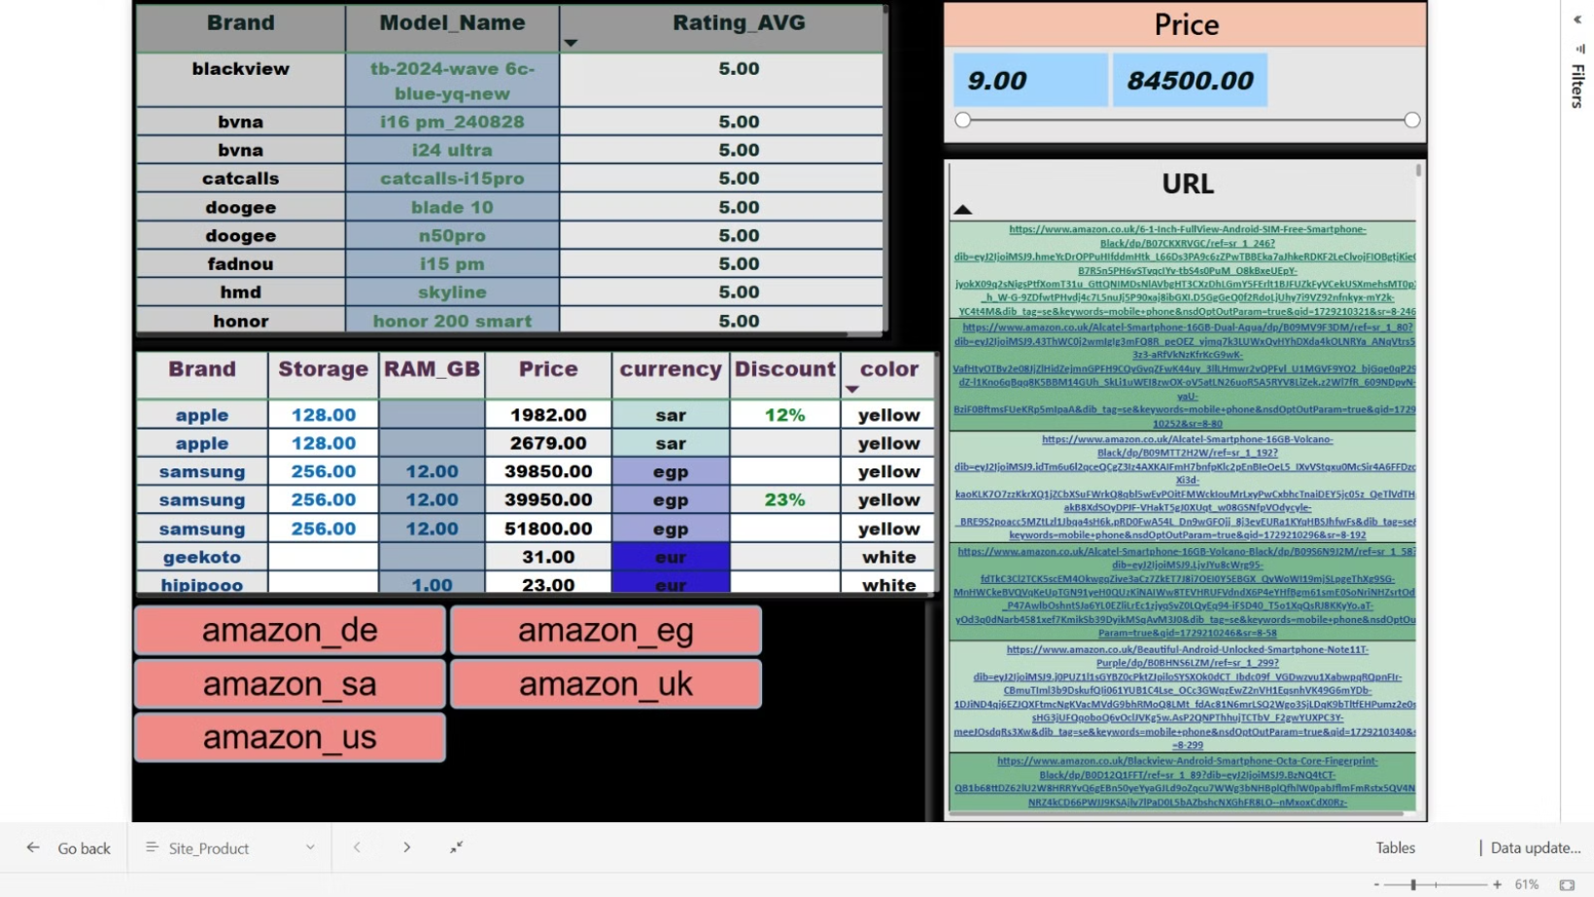

Slide 15
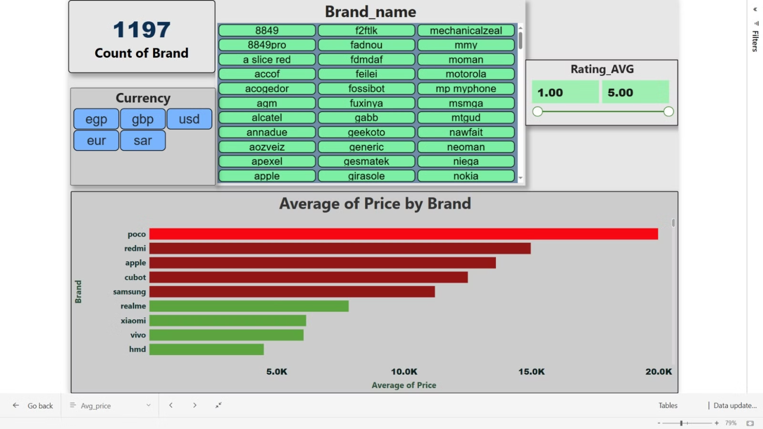

Slide 16



